Slide 1
State Income Tax Refund & Alimony
Pub 17, Chapters 12 & 18
(Federal 1040-Lines 10 & 11)
(NJ 1040-Line 24)
Notes:
1

Slide 2
Recoveries
Return of an amount you deducted or took a credit for in an earlier year
Most common recoveries are refunds, reimbursements, and rebates of deductions itemized on Schedule A:
State income tax refund
Property tax reimbursement (PTR) – covered in later module
Homestead Benefit – covered in later module
Others – such as medical expense reimbursement
Notes:
2

Slide 3
Recoveries
(cont’d)
Tax benefit rule
Must include a recovery in your income in the year you receive it up to the amount by which the deduction/credit you took for the recovered amount reduced your tax in earlier year
Use State Tax Refund Worksheet to determine how much of recovery has to be claimed in current year
Notes:
If you claimed a deduction/credit, but didn’t actually take it or all of it…then you don’t have a recovery. Only recover up to the amount of what you took.
3

Slide 4
NJ Income Tax Refund May Be Taxable
NJ income tax refund received in current year relating to taxes paid in an earlier year
Can get info on NJ income tax refund from NJ Division of Taxation website Refund Lookup Tool
Link from TaxPrep4Free.org Preparer page to NJ Form 1099-G Inquiry
Need SS #, Date of Birth, Name, & Zip Code
Amount from previous year tax return must be verified since amount could have changed (error found, return amended, etc.)
Notes:
4

Slide 5
NJ Income Tax Refund May Be Taxable
(cont’d)
Determine if there was a tax benefit in earlier year from NJ income tax paid
No tax benefit in earlier year if:
Taxpayer did not itemize (used Standard Deduction) OR
Elected to deduct State & Local sales tax (Sch A Line 5b) instead of State & Local Income tax (Line 5a)
If no tax benefit in earlier year, don’t declare refund in current year
Check NO in box above 1040 Line 10
Notes:
5

Slide 6
NJ Income Tax Refund May Be Taxable
(cont’d)
Possible tax benefit in earlier year if:
Taxpayer itemized (Sch A) & claimed a deduction for State/Local taxes paid (Line 5a)
Check YES in box above 1040 Line 10
Refund is taxable only to the extent that:
State income tax deduction exceeds sales tax deduction
Itemized deductions exceed standard deduction
Use State Tax Refund Worksheet to determine taxable amount of refund
Reported on 1040 Line 10
NJ Tax Refund is not taxable in NJ – TW handles automatically
Notes:
6

Slide 7
TW 1040 - State Tax Refund – Fed 1040 Line 10
If question in box answered Yes, Line 10 turns red. Link to TW St Tax Refund Worksheet
Notes:
Answer YES to this question if taxpayer itemized deductions last year & received a NJ income tax refund in current year
Answer NO to this question if:
Taxpayer did not itemize last year OR
Taxpayer deducted NJ sales tax (Line 5b) instead of NJ income tax (Line 5a) on Schedule A last year
If you answer YES to this question, Line 10 gets underlined in RED. You must complete the State Tax Refund Worksheet to determine if the NJ income tax refund is taxable on the current year Federal return
7

Slide 8
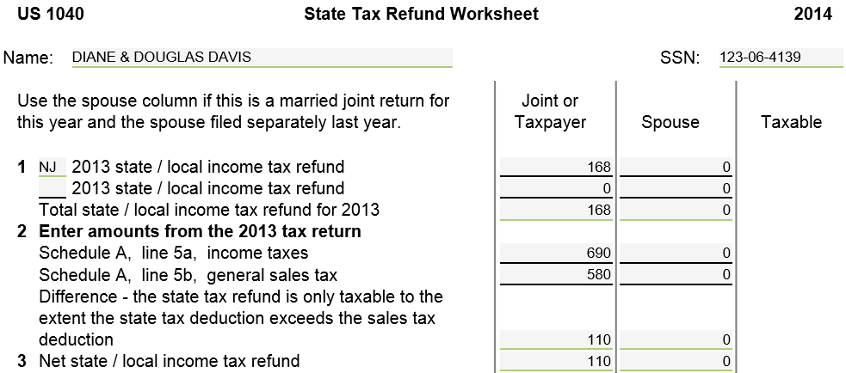
TW State Tax Refund Worksheet
TW will populate last year’s #s if carry-forward data is available
From last
year’s return
TWO calculates
May need to calculate using Sch A Sales Tax Table on TaxPrep4Free.org
Preparer page
Notes:
Pull up TW State Tax Refund Worksheet screen
Link from Line 10 on 1040 Page 1 (using arrow or F9) OR
Go directly to State Tax Refund Worksheet clicking on St Tax Refund in Forms Tree
Enter NJ Income Tax Refund from last year on Line 1
Enter appropriate data from last year’s tax return on Lines 2, 6, 7, 8, 12. Applicable lines #s from last year’s 1040 are given so you know where to get data
TW will populate last year’s amounts if carry-forward data is available
There is a link in the left-hand column of the Preparer page on the TaxPrep4Free.org website “Sch A Sales Tax Table” that you can use to calculate the Sch A, Line 5b General Sales Tax if no carry-forward data. May need to do this because last year’s printed return will not show sales tax amount (Line 5b) if income tax (Line 5a) was claimed
NJ income tax refund is only taxable to the extent that last year’s NJ income tax deduction exceeded last year’s NJ sales tax deduction. Otherwise, taxpayer would have taken sales tax deduction
Notice that NJ income tax refund last year was $168 but Net refund on Line 3 is only $110. That is amount by which Schedule A Line 5a State Income Taxes exceeded Line 5b Sales Tax
8

Slide 9
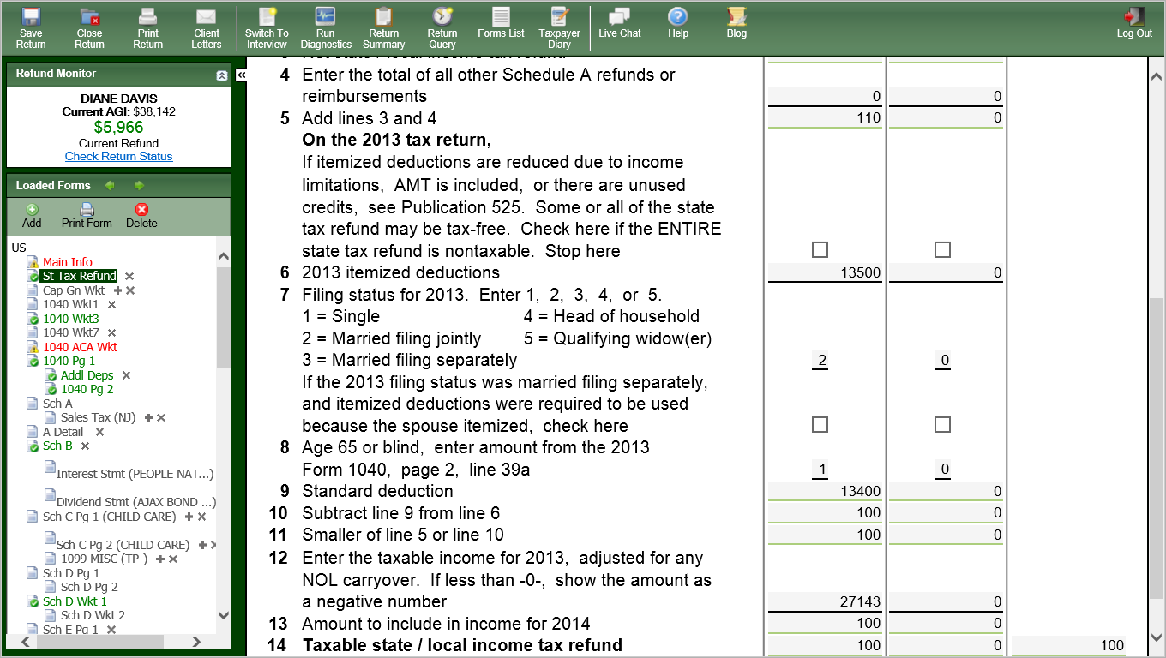
TW State Tax Refund Worksheet
(cont’d)
From last year ‘s
return
TW calculates
* Last year’s taxable income is AGI (Line 38) minus deductions (line 40) + Exemptions (Line 41). Could be a negative #. Do not just use Taxable Income from Line 43
Notes:
NJ income tax refund will only be taxable to the extent that last year’s itemized deductions exceeded last year’s standard deduction. Otherwise, taxpayer would have taken standard deduction
Enter # of extra deductions claimed last year due to Age 65 or blind on Line 8 (if appropriate) – not always in red
Enter taxable income from last year on Line 12
Last year taxable income is AGI (Line 38) minus deductions (line 40) + Exemptions (Line 41). Could be a negative #. Do not just use Taxable Income from Line 43
TW will calculate the taxable amount of the NJ income tax refund on Line 14
Notice that only $100 of the refund is taxable. That is the amount by which last year’s Itemized Deductions on Line 6 ($13,500) exceeded last year’s Standard Deduction on Line 9 ($13,400)
9

Slide 10
TW 1040 Line 10 – State Tax Refund
TW transfers from State
Tax Refund Worksheet
Notes:
TW will transfer the taxable amount of the state income tax refund on Line 14 of the State Tax Refund Worksheet to 1040 Page 1 Line 10
10

Slide 11
State Income Tax Refund Worksheet – TW Tips
Enter amount of last year’s state income tax refund on Line 1 of State Tax Refund Worksheet
Enter appropriate data from last year’s tax return
Enter data on Lines 2, 6, 7 (underlined in red).
Enter # of extra deductions claimed last year due to Age 65 or Blind on Line 8 (if appropriate)
Enter taxable income from last year on Line 12*
TW will calculate the taxable amount of the refund on Line 14 & transfer that amount to 1040 Line 10
* Last year’s taxable income is AGI (Line 38) minus Deductions (Line 40) + Exemptions (Line 41). Could be a negative #. Do not just use Taxable Income from Line 43
Notes:
If last years taxable income 1040 line 43 is zero, (it may have actually been negative but shows as zero) you must recalculate to see if it was negative.
AGI line 38
Less line 40 itemized deductions
Less line 42 exemptions
===============
If this is a negative number, then populate that on line 12 of State Tax refund worksheet
11

Slide 12
Alimony
Pub 4012 Tab E
Payment to or for a spouse or former spouse under a divorce or separation agreement
Deductible by the payer
Income for the receiver
The amount is as specified in the agreement – any other voluntary amounts are not income or deductible
Child support is not alimony
See Pub 4012 Tab E for alimony requirements
In TaxWise, alimony is entered directly on 1040 Line 11. It flows through to NJ 1040 Line 24
Notes:
Note: Just because the court ordered Alimony, doesn’t mean that it was paid

Slide 13
TW 1040 Line 11 - Alimony Received
Pub 4012 Tab E
Alimony Received Is Taxable
Notes:
13
Alimony can be entered directly on 1040 Line 11
Pub 4012 Page E-3 lists all the requirements for payments to be considered alimony. Examples are:
Payments must be required by a divorce or separation agreement
Payer and recipient cannot file a joint return with each other
There is no tax document for alimony. You must ask client. Last year’s return might give you a clue
Note: You can claim alimony you paid as an adjustment to income on 1040 Line 31 (covered in a later module)
Note: Legal child support is not taxable to the recipient

